Slide 1
Step 3 – Add A Todo
Pop-up's, cleaner code and form/text inputs.

Slide 2
Floating Action Button
For this Todo app lets add a floating action button to handle the adding a new Todo.
This button will present the user with options to add a new Todo.
In the scaffold, after the body, add a floatingActionButton: parameter.
Create a new FloatingActionButton() with three parameters:
onPressed:
tooltip:
child:
The on pressed is like an event handler you may have seen from JavaScript or other event driven programming styles.

Slide 3
Floating Action Button - onPressed
For the onPressed parameter we must pass it a function that will be called (the callback) for the function when it is pressed.
Anywhere inside your state object, create a new function with no return type called _openAddTodo.
Remember the underscore means this function is private.
It requires no input parameters because we're still working in the stateful widget.
Add this function to the onPressed parameter as a reference not by calling the function. I.e. without the parentheses.
Calling the function: _openAddTodo()
Passing Reference to function: _openAddTodo
Fill the tooltip and add a child of a const icon with the Icons.add in it.

Slide 4
ShowDialog()
To easily present a pop up we can use the ShowDialog() function.
It takes a context and a builder (like our list builder) which expects a widget to be returned.
For the popup we'll return an AlertDialog widget.
Create this widget and in its content create a column with children that represent the fields for the Todo data.
To position this Column, set its mainAxisSize to MainAxisSize.min.
In the children we can lay out our visual elements from top to bottom.

Slide 5
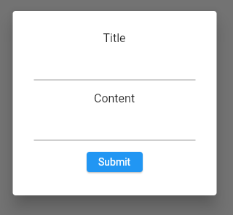
ShowDialog() UI Exercise
We're aiming to create this UI:
To space Widgets out wrap them in a Padding widget with EdgeInsets.
TextFormField
Text
ElevatedButton

Slide 6
TextFormField
This widget handles inputs.
However, it requires a controller to handle the text editing functionality the user can perform.
At the top of the _TodoHomePageState class near your Todo's add two TextEditingController's and instantiate them.
Give them appropriate names.

Slide 7
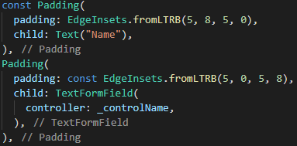
TextFormField
Now we can add these to the controller parameter of each TextFormField.
Make sure you match the field with the correct controller.
We will use these later to fetch the data and create the Todo object.
You should end up with something like this for both:

Slide 8
TextEditingController
Finally, we can use the TextEditingController to fetch the text the user has entered when the submit button is pressed.
Inside the onPressed: of the elevated button create an anonymous function with a body.
() {}
Inside call setState(){}
Inside that call todos.add();
Pass in the todo object by calling the constructor passing through the controller.text property.
Todo(name: <controller>.text, description: <controller>.text)
Finally, call Navigator.pop(context) to close the alert.

Slide 9
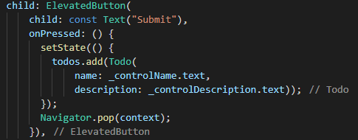
Final Adding of Todo
You should end up with something like this, test it works:

